Slide 1


SEO Navigator: From Audit to Action

Slide 2
Introduction:
Company Chosen: JustBilling
Website: https://justbilling.in
About the Company:
JustBilling is a billing and business management software for small businesses like retail shops, salons, and restaurants. It helps with GST billing, inventory tracking, reports, and cloud data backup.
Project Goal:
To perform a basic SEO audit, followed by keyword research, competitor analysis, content strategy development, and a comprehensive SEO strategy document.

Slide 3

Initial SEO Audit Analysis
Purpose of Audit:
The purpose of this audit is to evaluate the website’s technical SEO, on-page elements, and off-page presence. The goal is to identify issues that may affect the site’s organic visibility and recommend actionable improvements.
Initial SEO audit report

Slide 4
SWOT Analysis
Strengths (S):
Strong backlink profile (2.8k backlinks, 254 referring domains)
Mobile-friendly with good usability score (91/100)
Desktop & mobile page speed scores are decent
Weaknesses (W):
Meta description exceeds ideal limit (162 characters)
Poor contrast in content visibility affects accessibility
Opportunity(O):
Add alt text to all images to boost image SEO
Build online reputation via reviews, testimonials, and trust signals
Threats (T):
Low domain authority (45) compared to leading competitors
Competitors with better-structured content may outrank JustBilling

Slide 5

Keyword Research
In this task, I selected two core services offered by justbilling: Retail POS software and Restaurant POS software.
I performed keyword research using free tools like wordstream focusing on relevant search terms with good volume and low to medium competition.
  Keyword report
Justbilling can improve SEO by targeting low-competition keywords that are directly aligned with their product features.

Slide 6
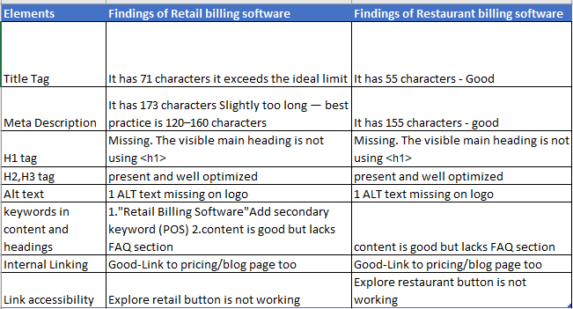
On-Page SEO Optimization Audit
Analysis of On-Page SEO audit of two key website pages to evaluate their titles, meta descriptions, HTML tags, keyword usage, linking structure, and image optimization. The summary of findings is shown below:

Slide 7
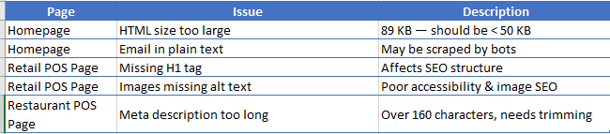
Technical SEO
The JustBilling website has a decent technical SEO foundation. It uses HTTPS, has a robots.txt file, is mobile-friendly, and is indexable by search engines.
However, some issues were identified on the homepage and product pages such as slightly large HTML file sizes, missing image alt tags, and exposure of email addresses in plain text.
List the technical SEO issues (homepage + 2 pages

Slide 8
5 Best practices to improve site & page speed
Best Practice | Explanation
1. Compress Images | Compress images using formats like WebP and AVIF to reduce load time.
2. Minify CSS, JS, HTML | Remove unnecessary code to reduce load time
3. Enable Browser Caching | Store static files locally so returning visitors load pages faster
4. Add Lazy Loading to Images | Add loading="lazy" to image tags to delay loading until scroll which can help improve first-page load speed
5. Reduce Server Response Time | Choose a good hosting provider and optimize backend queries

Slide 9
Content Strategy
Create a blogs article : What do we need first to start the business? What is GST Billing and Why Retailers Must Use It?
➤ Purpose: Attract users who are learning and searching for “gst billing” move them into buyers
Social Media Content Post weekly on platforms like LinkedIn, Facebook, and Instagram to highlight POS software features, share customer success stories, and showcase real-life use cases.
➤ Purpose: Build awareness among local and small business owners; supports local SEO and engagement
Educational blog post: "Why Accounting Software Is Not Enough – POS vs. Accounting Tools”
➤ Purpose: Target users searching “accounting software for small business” and explain why POS is better.

Slide 10
Webinar: 5 Signs You Need to Upgrade Your Billing System” + Live Q&A Demo
➤ Purpose: Drive traffic, capture leads, and explain product benefits in real-time.
Blog article for comparisons: “Best POS Systems for Restaurants in 2025 – Comparison & Features”
➤ Purpose: Rank for keywords like “best restaurant POS”, “most popular restaurant pos”; support buyers in decision-making

Slide 11
Create a SEO Strategy and Recommendation
A comprehensive SEO strategy outlining actionable recommendations for improving search visibility, organic traffic, and website performance
With these suggestions, JustBilling can improve its website SEO and attract more users from Google. If they continue to update their site with helpful content and fix technical issues, they will be able to rank higher and compete better with other POS software companies
Strategy and overall report

Slide 12

Thank You

